Slide 1
Weekly Review

Slide 2
Duolingo
New League
Xavier, Emerald
14 – Day Streak
Parker Fink
Tyler Siegmund
New Challenger Approaching!
Jaysin Haugh

Slide 3
Pog Collections
Pog sheets: 2 pogs a piece, limited to 2
Bring me a pog sheet with 20 unique #CP pogs for a payout
Bring me a pog not currently in my collection for a payout

Slide 4
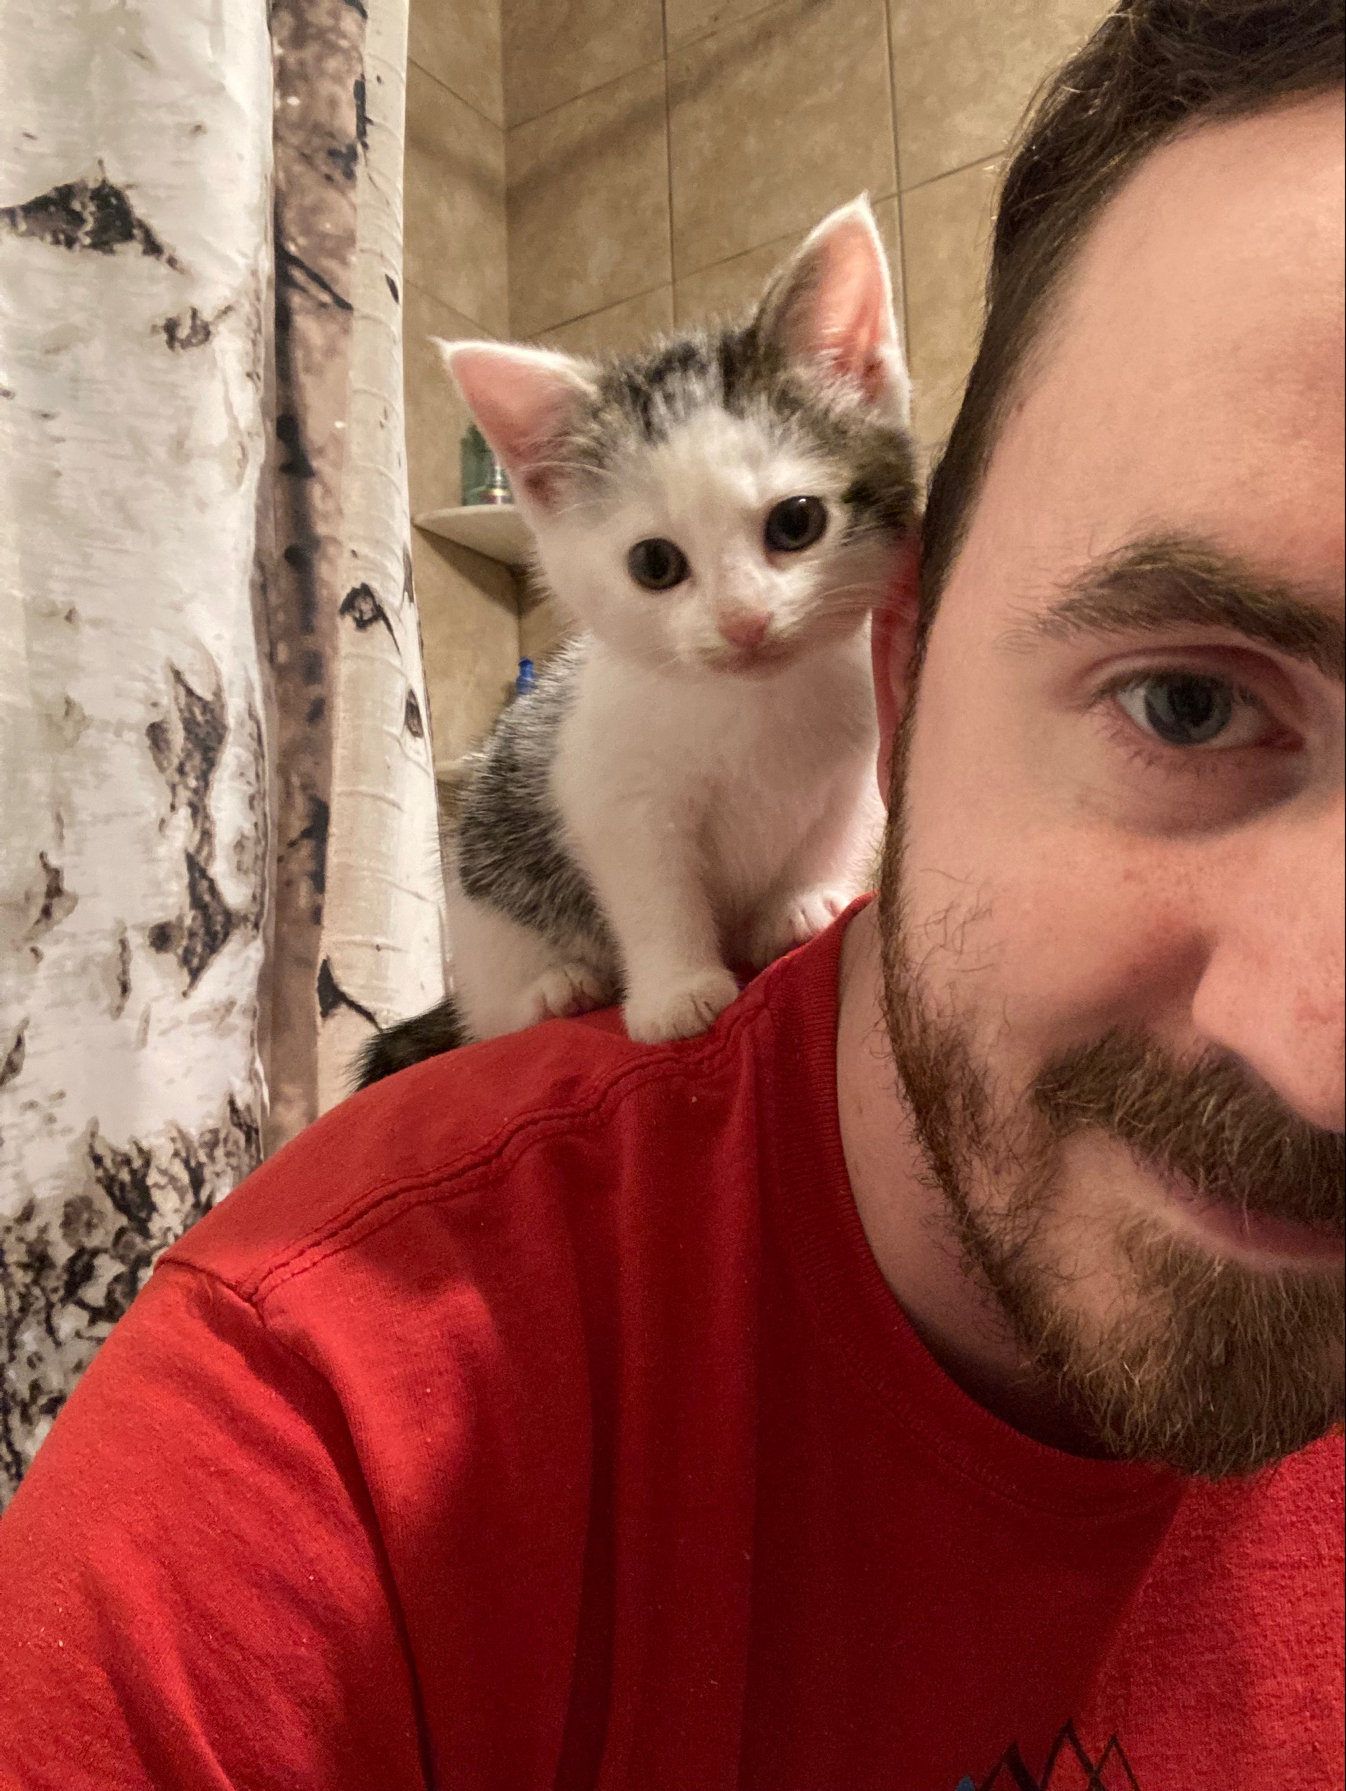
This week’s DocPacs
I will be setting up a Schoology assignment for Codecademy proof
This weekend I found a kitten
He is cuter than you have ever been, so I played with him instead of grading or lesson planning.
I will produce new DocPacs soon. Assume that you are continuing your Codecademy studies.

